Slide 1
Marshall
An Overview for El Dorado Hills Community Council

Slide 2
Marshall commits to creating a community where everyone can achieve their highest desired state of health and well-being.

Slide 3
Who we are
Marshall was built by the community it serves
Today we are
  111-bed general acute care hospital in Placerville
  16 outpatient clinics – primary and specialty care in Placerville, Georgetown, Cameron Park and El Dorado Hills
  Level III Trauma Center
  Marshall Cancer Center, an Affiliate of UC Davis Health
  ~1,600 employees and 150 practitioners

Slide 4
Yesterday…

Slide 5
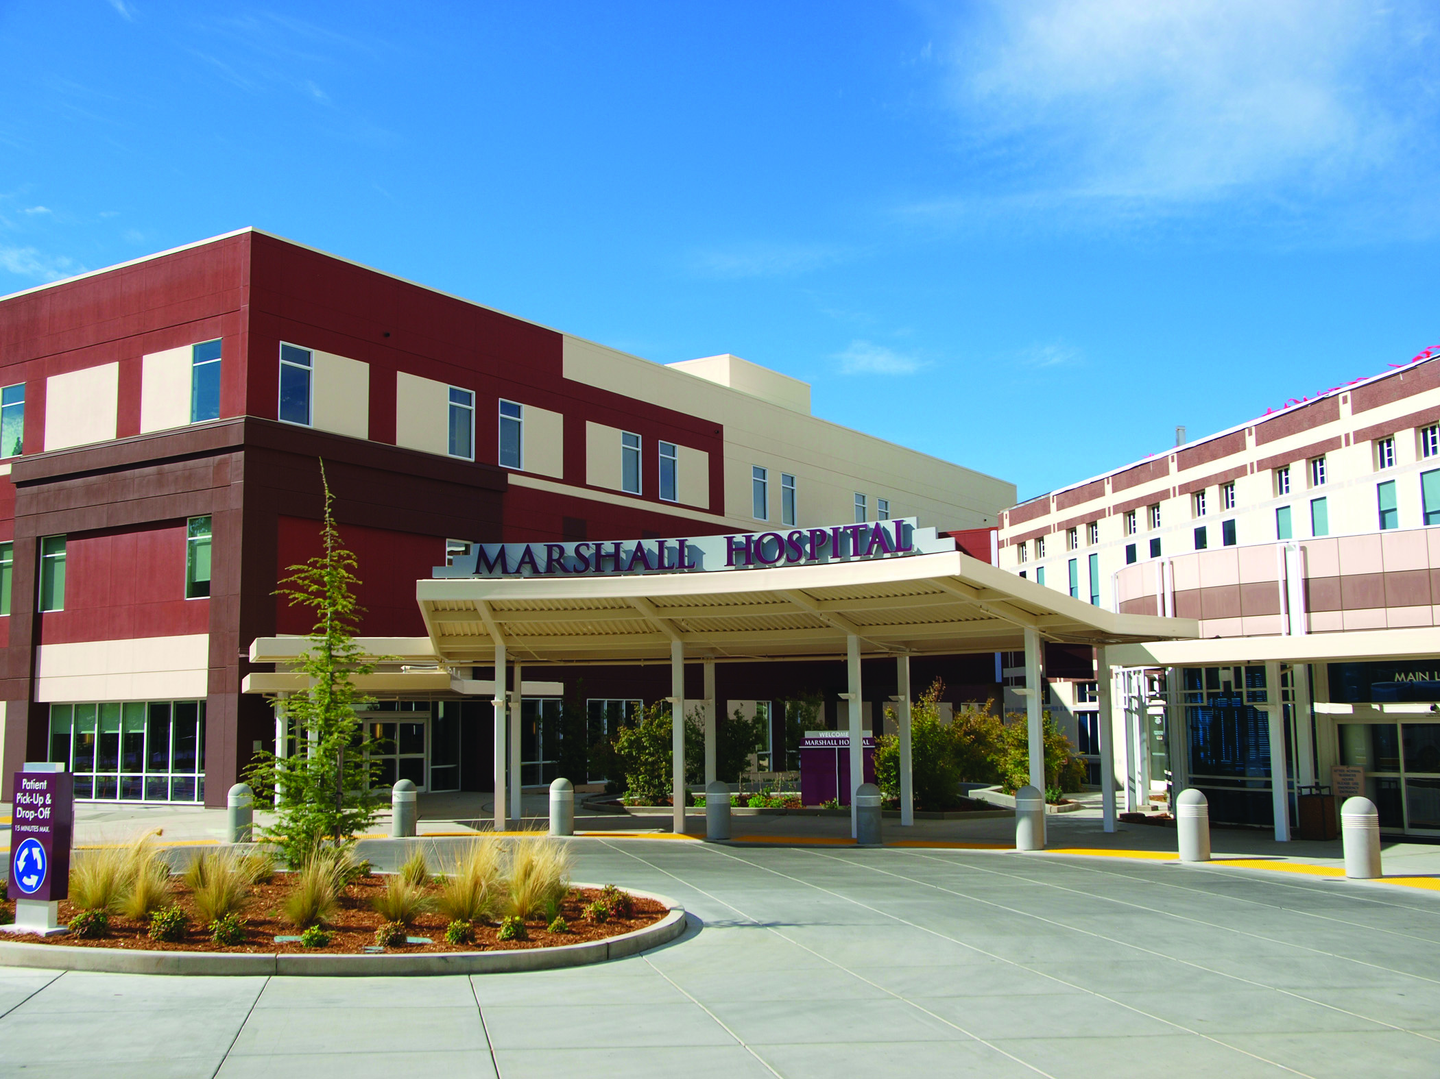
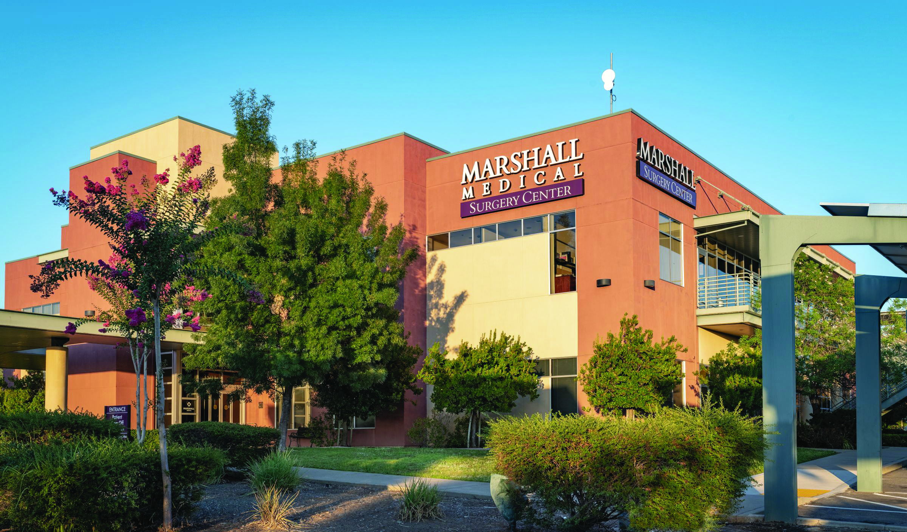
Today…

Slide 6
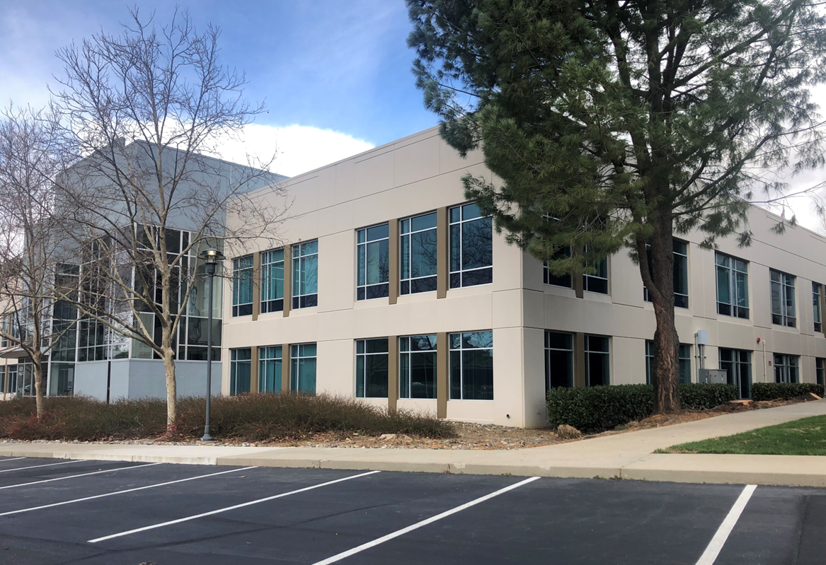
And tomorrow!

Slide 7
Our Plans for El Dorado Hills
25,000 SF clinic space on first floor
  Primary care
  Orthopedic clinic
  Physical therapy and rehabilitation
  Same-day orthopedic care
Other specialties may rotate in
Tenant improvements to commence soon
Opening Spring of 2025

Slide 9
What about the second floor?
Convening with strategic partners
Board and executive leadership direction
El Dorado Hills Healthcare Advisory Committee recommendations
Financing is a challenge…

Slide 10
Seismic Mandate Challenges and Next Steps
SB 1953 – Seismic Standards for Hospitals

Slide 11
Background
SB 1953 Passed in 1994
Conforming hospital buildings is an unfunded mandate
Extended in 2007, 2012, and 2020
Current deadline 2030
  Might be extended – SB 1432
51% of California hospitals not likely to meet the deadline
Marshall has met 2020 “Safe and standing” requirements

Slide 12
Impacts of current requirements
Marshall’s estimated costs to comply to 2030 standard is $85 million
  In addition to $68 million already spent
Financing is a challenge and service lines are competing for dollars

Slide 13
Financial Impacts
The cost of meeting the 2030 requirements is equivalent to:
  Employing 530 nurses
  Caring for 6,128 patients
  Running our emergency department for 5 years
  Having OB available for 7.8 years
  Foregoing most new projects or service lines, new locations, and other facilities upgrades

Slide 14
California Hospital Association Survey

Slide 15
Discussion
Thank you!

