Slide 1



EL DORADO COUNTY PROBATION DEPARTMENT
OPIOID SETTLEMENT FUNDING IMPLEMENTATION PLAN
Safe Communities through Changed Lives
JULY 1, 2024
Notes:
Introduction
Nikki Moeszinger, Chief Fiscal Officer, El Dorado County Probation Department
17 Years with Probation, 18 with the County

Slide 2

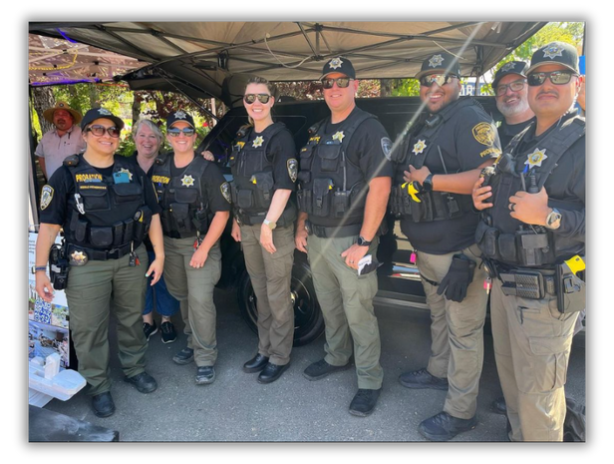

Mission
Providing Public Safety through Collaborative Partnerships and Innovative Practices in Corrections with Accountability and Compassion
Values
We Believe Our Well Trained, Dedicated, & Compassionate Employees are the Probation Department’s Most Valueable Asset
We are Committed to:
  Respecting Human Rights & Diversity
  Fostering Transparency through Accountability and Communication
  Providing Exemplary Service by Leading with Integrity, Humility, Honesty, and Equality
Vision
Safe Communities through Changed Lives

Slide 3


Background
California Attorney General Rob Bonta announced the final settlement agreements with prescription opioid manufacturer Janssen Pharmaceuticals and pharmaceutical distributors McKesson, Cardinal Health, and AmerisourceBergen (the Janssen and Distributors, or J&D Settlement) that is set to provide substantial funds for the abatement of the opioid epidemic in California
These settlements are worth up to $26 billion of which CA is expected to receive $2.05 billion through 2038
The Department of Health Care Services (DCHS) is the oversight and monitoring entity for funds received through these settlements, and the majority of funds will be provided to participating subdivisions.
El Dorado County is a subdivision and will receive funds to be used for opioid abatement activities.
Notes:
Throughout the opioid overdose epidemic, state, local, and tribal governments have brought lawsuits against pharmaceutical and drug distribution companies to recover costs associated with the epidemic and ensure that
future crises are prevented.
El Dorado County is the recipient of opioid settlement funds which are required to be spent
on opioid remediation activities. Allowable expenditures must include activities tied to the
ending, reduction or lessening the effects of the opioid epidemic in communities and include
prevention, intervention, harm reduction, treatment, and recovery services.

Slide 4
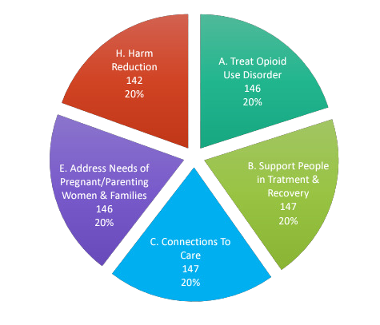

El Dorado County
Health & Human Services Administration
  Nicole Ebrahimi-Nuyken , LMFT
    Behavioral Health Director
  Salina Drennan
    Alcohol & Drug Programs Division Manager
  Committee Established
  Survey - Identified & Prioritized 12 Focus Areas
  Invitation to Apply for Funding Received on June 19, 2023
  8 Applications Received Requesting Over $2 Million in Year-One Funding
  $1.2 Million Available for Competitive Grants
  All Applicants Received Approximately 60% of the Requested Funding
Notes:
The County is committed to utilizing these funds in alignment with the local needs of the community and has engaged stakeholders through various meetings, informational emails, a
survey, and presentation of survey results. The County is utilizing this opportunity to provide grants to appropriate entities that are qualified to facilitate and/or provide opioid remediation activities to our community. Based upon feedback from stakeholders and in accordance with the DHCS allowable expenses document, five top local priorities were
identified.
Survey had 153 participants
-The survey was intended to gather stakeholder input on where El Dorado County should set its priority for the use of the funds. They asked respondents to review and provide their input on the list of allowable expenses in the areas of prevention, intervention, harm reduction, and/or treatment & recovery services.
Survey distributed: 04/06/2023 •
Survey closed: 04/14/2023 • Totals respondents: 153
TREAT OPIOID USE DISORDER (OUD)
SUPPORT PEOPLE IN TREATMENT AND RECOVERY
CONNECT PEOPLE WHO NEED HELP TO THE HELP THEY NEED (CONNECTIONS TO CARE)
ADDRESS THE NEEDS OF CRIMINAL JUSTICE-INVOLVED PERSONS
ADDRESS THE NEEDS OF PREGNANT OR PARENTING WOMEN AND THEIR FAMILIES, INCLUDING BABIES WITH NEONATAL ABSTINENCE SYNDROME
PREVENT OVER-PRESCRIBING AND ENSURE APPROPRIATE PRESCRIBINGAND DISPENSING OF OPIOIDS
PREVENT MISUSE OF OPIOIDS PREVENT OVERDOSE DEATHS AND OTHER HARMS (HARM REDUCTION)
FIRST RESPONDERS
LEADERSHIP, PLANNING AND COORDINATION
TRAINING
RESEARCH
Behavioral Health's Director, Nicole Ebrahimi-Nuyken, and Division Manager Salina Drennan for bringing this opportunity to our attention.
A special thank you to our own Grants Analyst, Geri Payne for the development of our submission.

Slide 5


Funding Objectives
Opioid Remediation Activities
  TREAT OPIOID USE DISORDER (OUD)
    Support treatment of OUD and any co-occurring Substance Use Disorder or Mental Health (SUD/MH) conditions through evidence-based or evidence-informed programs or strategies
  SUPPORT PEOPLE IN TREATMENT AND RECOVERY
    Support people in recovery from OUD and any co-occurring SUD/MH conditions through evidence-based or evidence-informed programs or strategies
  CONNECT PEOPLE WHO NEED HELP TO THE HELP THEY NEED (CONNECTIONS TO CARE)
    Provide connections to care for people who have - or are at risk of developing OUD and any co-occurring SUD/MH conditions through evidence-based or evidence-informed programs or strategies
  ADDRESS THE NEEDS OF PREGNANT OR PARENTING WOMEN AND THEIR FAMILIES, INCLUDING BABIES WITH NEONATAL ABSTINENCE SYNDROME
    Address the needs of pregnant or parenting women with OUD and any co-occurring SUD/MH conditions, and the needs of their families, including babies with NAS, through evidence-based or evidence-informed programs or strategies

Slide 6

Probation Department
Opioid Education Program
Facilitate Connections for Individuals
Access to Key Services & Resources
Target Population
Offer Triage & Referral Services
Provide Education and Resources
Notes:
Use of these funds will accelerate the operationalization of our outreach effort.
Our primary objective outlined in the award application is to facilitate connections for individuals whose lives have been altered through opioid use and mental health disorders with access to key services and resources.
Specifically, these individuals are increasingly vulnerable within the initial 72 hours post-release from jails, and often are experiencing or at risk for homelessness.
As detailed in our Mission, by maximizing our collaborative partnerships with community health and public safety agencies, we will position our Probation Outreach vehicle to engage directly with members of our community, meeting people where they are.
This unique and innovative approach will differ from traditional probation services, by working with individuals prior to formal conviction/adjudication court processes.
This program will offer triage and referral services, provide opioid education, and provide additional resources to address vulnerabilities promptly, continuing efforts toward achieving our vision of safe communities through changed lives.

Slide 7

Opioid Education Program
Goal #1 Develop Outreach Education Program Infrastructure
Objectives
  Hire 1.0 FTE Health Educator
  Partner with Public Safety & Community Partner Agencies to Collaborate Efforts at Homeless Encampments
  Develop Location Schedule
  Train Staff for Specialized Assignment
  Purchase Necessary Equipment
  Purchase Bus Passes & Other Transportation Resources for Individual Access to Services

Slide 8
Opioid Education Program
Goal #2 Measuring Impact, Building Communication, & Increasing Access to Services
Objectives
  Create Touchpoint Profile for Non-Justice Involved Individuals
  Create Ad-Hoc Report to Track Referrals
  Develop Process for Notification of Pending Release Dates
  Provide Case Planning Services for All Justice Involved Individuals Referred or Engaged by OEP
  Provide Transportation/Fuel/Bus Passes As Needed for Warm-Handoff to Recovery Services
Notes:
Use of these funds will accelerate the operationalization of our outreach effort.
Our primary objective outlined in the award application is to facilitate connections for individuals whose lives have been altered through opioid use and mental health disorders with access to key services and resources.
Specifically, these individuals are increasingly vulnerable within the initial 72 hours post-release from jails, and often are experiencing or at risk for homelessness.
As detailed in our Mission, by maximizing our collaborative partnerships with community health and public safety agencies, we will position our Probation Outreach vehicle to engage directly with members of our community, meeting people where they are.
This program will offer triage and referral services, provide opioid education, and provide additional resources to address vulnerabilities promptly, continuing efforts toward achieving our vision of safe communities through changed lives.

Slide 9
Opioid Education Program
Goal #3 Reduce Stigma & Connect Individuals at their Most Vulnerable Times with Services and Resources Directly in the Community
Objectives
  Procure Naloxone for Distribution from CDHS
  Administering Naloxone Trainings for Family & Community Members Closely Impacted by Opioid Use
  Leave Flexibility in the OEP Mobile Unit Schedule to Make Changes to Locations Based on Community and Collaborative Partner Feedback
  Provide Transportation Services As Needed
  Increase Capacity of Referral Resources
  Distribute Factual Materials & References About OUD Treatment and Services

Slide 10
Opioid Education Program
Performance Measures
Report on the Number of:
  Individuals Engaged by HE
  Locations Served
  Referrals Received
  Referrals to Evidence Based Treatment Providers and Services
  Transports
  Bus Passes Issued
  Individuals Assigned to OEP
  Naloxone Units Distributed
  Resources added to EDC Community Resource Guide
  OUD Treatment and Service Materials Distributed
Notes:
Use of these funds will accelerate the operationalization of our outreach effort.
Our primary objective outlined in the award application is to facilitate connections for individuals whose lives have been altered through opioid use and mental health disorders with access to key services and resources.
Specifically, these individuals are increasingly vulnerable within the initial 72 hours post-release from jails, and often are experiencing or at risk for homelessness.
As detailed in our Mission, by maximizing our collaborative partnerships with community health and public safety agencies, we will position our Probation Outreach vehicle to engage directly with members of our community, meeting people where they are.
This program will offer triage and referral services, provide opioid education, and provide additional resources to address vulnerabilities promptly, continuing efforts toward achieving our vision of safe communities through changed lives.

Slide 11

$192,811.30
PERSONNEL $153,223
1.0 FTE Health Education Coordinator $153,223
Probation OSF Budget
EQUIPMENT $9,360
2 Getac Computers $6,000
GPS/Satellite Radio + Equipment $3,000
CradlePoint $360
SUPPLIES $12,700
Mileage & Fuel $3,000
Printing Services $500
Bus Passes $1,200
Specialized Opioid Recovery Training for Staff $8,000
INDIRECT COST 10% $17,528.30

Slide 12

Year 1
BOS Approved MOU with HHSA on 05/21/2024
  BOS Item #24-0258 HHSA Opioid Settlement Funding Out Agreements
  1.0 FTE Approved for Fiscal Year 2024/2025
    Recruitment Preparation Began 05/2024
    Posting Should Occur 07/2024
The Probation Department will Receive Outreach Trailer in the First Week of July 2024
  Begin Purchase of Equipment
  Train Staff Assigned to OEP
  Work w/ HHSA on Materials for Distribution Development
  Developing Schedule of Locations
    Develop MOU w/ County Library, Sheriff (Jails), Superior Courts
    Publish Schedule
Probation is collaborating with other recipients of Opioid Settlement Funds

Slide 13


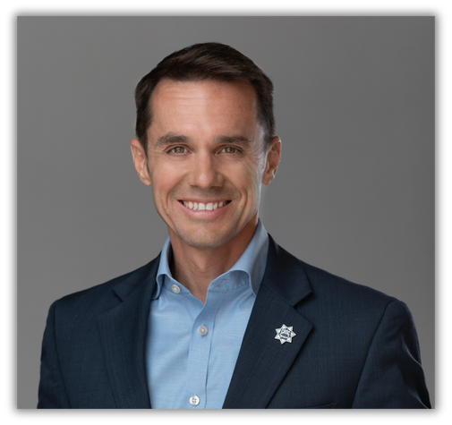

Probation Department Contact Information
Nikki Moeszinger
Chief Fiscal Officer
El Dorado County Probation Department
Phone: 530-621-6066
Email: nikki.moeszinger@edcgov.us
Geri Payne
Grants Administrative Analyst
El Dorado County Probation Department
Phone: 530-621-6079
Email: geri.payne@edcgov.us
Brian J. Richart
Chief Probation Officer
El Dorado County Probation Department
Phone: 530-621-5625
Email: brian.richart@edcgov.us

Slide 14

Questions?

